Slide 1
Discrete Maths (DM) -Group:2
Ayush Kesharwani – 026
Vivek Maru – 036
Akshat Parmar – 051
Anika Nair – 045
Aman shaikh – 069

Slide 2
Predicates
Suppose we have equations as : x>3
We cant say the above the equations as statement cause it dosen’t have a TRUE or FALSE value
Once we assignee values to the variables then the equation will be called statements because then they will have TRUE or FALSE values

Slide 3
Now in the equation x is greater than 3 has two parts
The first part the variable x , is the subject of the statement
The second part is the predicate i.e ‘is greater than 3’
We denote the eqn ‘x is greater than 3’ as P(x) where P denotes the predicate i.e ‘is greater than 3’ and x is the variable
P(x) is also called propositional function P at x. when a value is assigned to the variable x,
The statement P(x) becomes a proposition and has a truth value

Slide 4
Types of Predicate
x is a subject & is greater than 3 => predicate
if only one variable then P(x) => unary predicate
if two variable then P(x,y) => binary predicate
if n variables than P(x1,x2……xn) => n-place predicate

Slide 5
Lets see some examples
1) Q( x , y ) : x = y + 3 Q( 1 , 2) : ? Q( 3 , 0) : ?
Soln: Q(1,2): 1=2+3 Q(1,2):1=5 => false Q(3,0):3=0+3 Q(3,0):3=3 => true
After assigning the values the equation got a true or false value

Slide 6
2) R(x , y , z): x + y = z
R(1 , 2 , 3): ?
R(0 , 0 , 1): ?
Soln:
R(1,2,3): 1+2=3
R(1,2,3): 3=3 => true
R(0,0,1): 0+0=1
R(0,0,1): 0=1 => false

Slide 7
Preconditions and Postconditions
Predicates are also used to establish the correctness of computer programs
This is to show that the computer program always produces the desired output when given valid input.
The statements that describe valid input are known as precondition
And the conditions that the output should satisfy when the program has run are known as postconditions

Slide 8
Lets understand with Example
Consider the following program, designed to interchange the values of two variables x and y.
temp := x x := y y := temp
So, for this precondition, we can use the predicate P(x,y), Where P(x,y)=(a,b)
Here x and y are the values before we run the program (precondition)
For the post condition we can use Q(x,y),
Where Q(x,y)=(b,a)

Slide 9
The first step of the program, temp := x, assigns the value of x to the variable temp,
so after this step we know that x = a, temp = a, and y = b.
After the second step of the program, x := y, we know that x = b, temp = a, and y = b.
Finally, after the third step, we know that x = b, temp = a, and y = a.
Consequently, after this program is run, the postcondition Q(x, y) holds, that is,
the statement “x = b and y = a” is true.

Slide 10
Quantifiers
When the variables in a equation are assigned values, the resulting statement becomes a proposition with a certain truth value.
However, there is another important way, called quantification, to create a proposition from a propositional function.
Quantification expresses the extent to which a predicate is true over a range of elements. (For example in the first example x>3 we can’t take x=group2 cause then we can’t compare them)
In English, the words all, some, many, none, and few are used in quantifications.

Slide 11

Types of Quantifier
There are two types of quantification here
Universal Quantifier (∀)
Existential Quantifier ($∃$)

Slide 12
Universal Quantifier (∀)
It is true predicate for every element under consideration.
The universal quantification of P(x) is the statement “P(x) for all values of x in the domain”
The notation ∀xP(x) denotes the universal quantification of P(x)
Here ∀ is the universal quantifier
An element for which P (x) is false is called a counterexample of ∀xP(x)

Slide 13
Note:-
∀xP(x) becomes TRUE when P(x) is TRUE for every x And it becomes, FALSE if there is an x for which P(x) is false
When P(x) is TRUE for all values of a variable in a particular domain,
Then the domain is called domain of discourse or the universe of discourse
∀x means for every, for arbitrary, for each, given any, all of, etc

Slide 14
Example
P(x): x + 1 > x ,Domain : set of real no’s Soln: is true for all x
2) Q(x) : x < 2 where x € set of real no’s Soln: is false , Counterexample: when x=3 it is false

Slide 15
3) Find the value of where P(x): x^2<10 and domain consist of positive integers not exceeding 4. Soln: is false, For x=4 Cause, x^2=4^2=16 which is greater than 10 ,P(4) is false

Slide 16
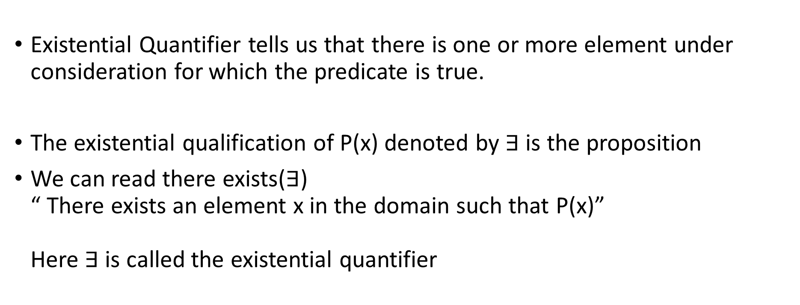

Existential Quantifier($∃$)
Existential Quantifier tells us that there is one or more element under consideration for which the predicate is true.
The existential qualification of P(x) denoted by $∃$ is the proposition
We can read there exists($∃$) “ There exists an element x in the domain such that P(x)” Here $∃$ is called the existential quantifier

Slide 17
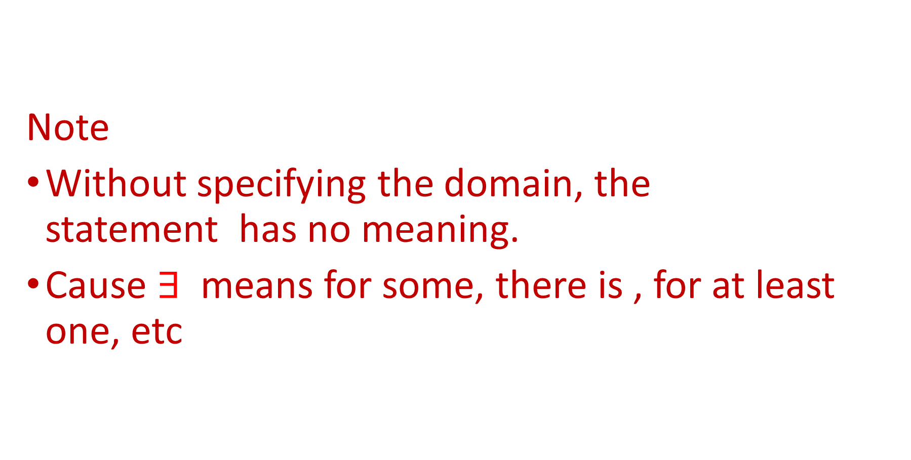
Note
Without specifying the domain, the statement has no meaning.
Cause $∃$ means for some, there is , for at least one, etc

Slide 18
Example
where P(x): x > 3, set of real no’s Soln: For, x=5 >3 a TRUE
where Q(x) : x = x + 1 , set of real no’s Soln: So, the above statement is false cause no value of x satisfies The given equation FALSE

Slide 19
3) where P(x) : x^2<10, domain consist of positive integers not exceeding than 4 Soln: The above equation is TRUE for x=1,x=2,x=3 And FALSE for x=4 So the above statement is TRUE for ‘there exists a x’

Slide 20
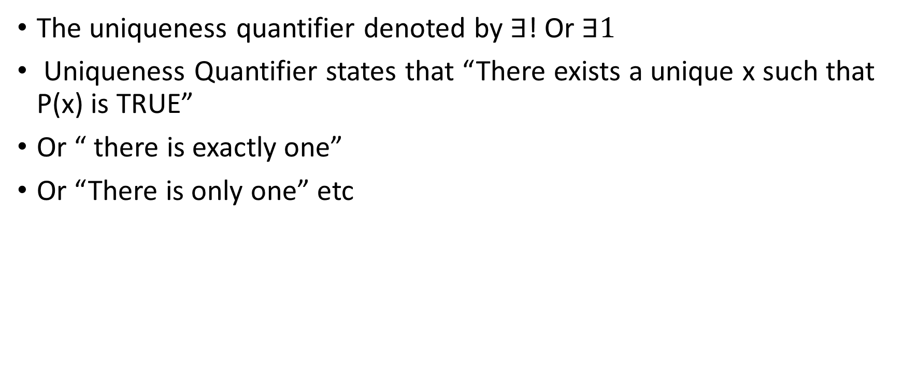
Uniqueness Quantifier
The uniqueness quantifier denoted by $∃$! Or $∃1$
Uniqueness Quantifier states that “There exists a unique x such that P(x) is TRUE”
Or “ there is exactly one”
Or “There is only one” etc

Slide 21
Arguments
An argument is a list of statements called premise ( or assumptions or hypotheses) followed by a statement called the conclusion
What is Premise? => It is a statement used as evidence for conclusion
What is conclusion here? => it is a statement supported by at least one premise

Slide 22
Representation of Argument
P1 Premise
P2 Premise
P3 Premise
.
.
.
Pn Premise
------------------
C => Conclusion

Slide 23
Example
Vivek is not well Vivek didn’t go to college Or Vivek is not going to college since he is not well

Slide 24
Valid Arguments
An Argument is valid if the conclusion is TRUE , when all the premises are TRUE
So we can represent Valid argument as; ( P1 & P2 & P3 ….. & Pn ) => C ( which should be tautology )

Slide 25
Example of valid Argument
Premise 1 : All healthy plants have green leaves
Premise 2: My plant is a healthy plant
Conclusion : So the leaves on my plant are green

Slide 26
Invalid Arguments
An Argument is invalid if the conclusion is FALSE.
It means the conjunction of its premise does not imply conclusions.

Slide 27
Example of Invalid Argument
The moon is yellow. Therefore, the moon is made of cheese.
Proof:-
Let P denote the simple statement The moon is yellow.
Let Q denote the simple statement The moon is made of cheese.
The argument can then be expressed as: (1 ): P
(2): .'. Q There is nothing connecting the two statements
Hence this is not a valid argument

Slide 28
Another example of Invalid Argument
The following is an invalid argument with true premises and a true conclusion:
If I am President then I am famous.
I am not President.
Therefore I am not famous.
Proof
It does not follow that just because I am not President that I am not famous.
The fact that I am indeed not famous is independent of the argument

Slide 29
Rules for Inference
Rules of Inference provide the guidelines for constructing valid arguments from the statements that we already have.

Slide 30
Some rules of Inference
Addition
Conjunction
Simplification
Modus Ponens
Modus Tollens

Slide 31
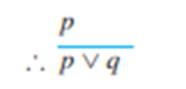
1. Addition
1111
If p is a premise, we can use Addition rule to derive p∨q
Let p be the proposition, “he studies very hard” is true
Therefore − "Either he studies very hard Or he is a very bad student." Here q is the proposition “he is a very bad student”.
Example

Slide 32
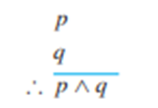
2. Conjunction
If p and q are two premises, we can use Conjunction rule to derive p∧q
Let p − “he studies very hard”
Let Q − “he is the best boy in the class”
Therefore − "He studies very hard and he is the best boy in the class"
Example

Slide 33
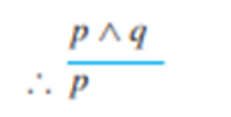
3. Simplification
If p ∧ q is a premise, we can use Simplification rule to derive p.
"he studies very hard and he is the best boy in the class", p ∧ q
Therefore − "he studies very hard"
Example

Slide 34
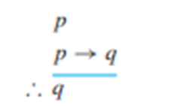
4. Modus Ponens
If p and p→q are two premises, we can use Modus Ponens to derive q.
"If you have a password, then you can log in to facebook", p → q
"You have a password", P
Therefore − "You can log in to facebook"
Example

Slide 35
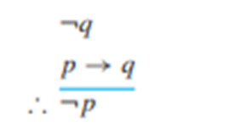
5. Modus Tollens
If ~q and p → q are two premises, we can use Modus Tollens to derive ~p.
"If you have a password, then you can log on to facebook", p → q
"You cannot log on to facebook", ¬q
Therefore − "You do not have a password "
Example

Slide 36
Thank You

